Slide 1

Ch.09 Creating Your Web Database
Siva R Jasthi
ICS325 – Internet Application Development
Information and Computer Sciences
Metropolitan State University

Slide 2
Outline
Creating a database
Setting up users and privileges
Introducing the privilege system
Creating database tables
Creating indexes
Choosing column types in MySQL

Slide 3
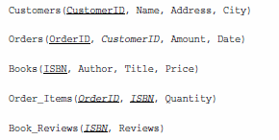
Book-O-Rama example
Book-O-Rama Schema:
Primary Key for each table is underlined
And each foreign key is italic.

Slide 4
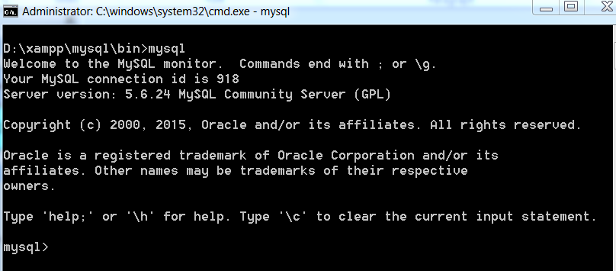
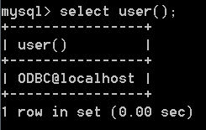
Running MySQL from Command Line Prompt
MySQL Monitor
If you launch MySQL with no user name, it launches the instance of MySQL as ODBC@localhost (ODBC = Open Database Connectivity)
It can be considered as anonymous user.

Slide 5
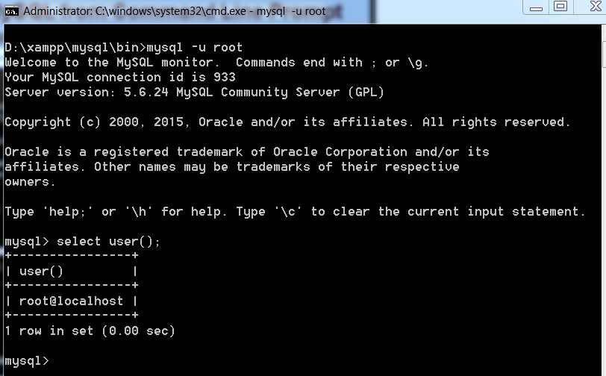
Running MySQL from Command Line Prompt
MySQL Monitor (launching as root)
You can launch MySQL with –u option (user name);

Slide 6
MySQL’s six command prompts
MySQL Prompt | Meaning
mysql> | MySQL is ready and waiting for a command
-> | Waiting for the next line of a command
‘> | Waiting for the next line of a string started with a single quote
“> | Waiting for the next line of a string started with a double quote
`> | Waiting for the next line of a string started with a backtick
/*> | Waiting for the next line of a comment started with /*

Slide 7
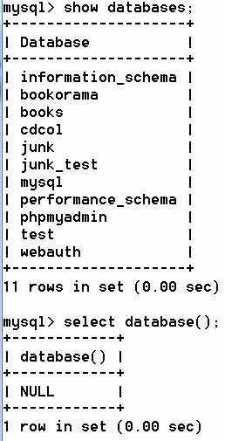
Running MySQL from Command Line Prompt
MySQL Monitor (launching as root)
Note that some SQL statements end with ( ). Those are SQL functions.
SHOW databases; is a SQL Statement.
SELECT database() is a SQL Function.

Slide 8
SQL commands are not case sensitive.
The SQL Keywords are case-insensitive ( SELECT , FROM , WHERE , etc), but are often written in all caps. (Note: In the text book, these commands are all written in lower case)
In some setups table and column names are case-sensitive (eg; LINUX). And those are case-insensitive (on Windows). However, it is always a good practice to ensure that your naming and usage follow consistent pattern.
mysql> DROP DATABASE annamayya;
Query OK, 0 rows affected (0.00 sec)
mysql> drop database annamayya;
ERROR 1008 (HY000): Can't drop database 'annamayya'; database doesn't exist
mysql> drop database if exists annamayya;
Query OK, 0 rows affected, 1 warning (0.00 sec)

Slide 9
Some useful commands
Knowing which version of MySQL you are running?
SELECT version();
2. What is the user id I logged in as? OR who started MySQL instance?
SELECT user(); SELECT current_user( );
3. What are all the databases available?
SHOW databases;
4. Creating a database
CREATE database <db_name>;
5. Selecting a database (or connecting to a database) (try it on mysql)
USE <db_name>;
6. What is the database currently in use?
SELECT database();
7. What are all the tables available in the currently selected database?
SHOW tables;
8. Creating an user
CREATE user xyz identified by ‘xyz123’;
9. Knowing the description of a table in a database
DESCRIBE <table_name>
10. Deleting a database
DROP database <db_name>;
11. Deleting a table (in an active/current database)
DROP table <table name>;
12. Showing all data in a table
SELECT * FROM <table name>;
13. Showing the number of rows in a table
SELECT COUNT(*) FROM <table name>;
14. Creating new user
USE mysql;
INSERT INTO user (Host, User, Password)
VALUES (‘%’, ‘username’, PASSWORD(‘pw%Enc’));
15. Updating the Privileges
FLUSH privileges;
16. Showing the privileges granted to a user
SHOW grants;

Slide 10
Be aware of the shortcuts and alternates
mysql> USE mysql;
The following three commands will produce the same output
mysql> DESCRIBE user;
mysql> DESC user;
mysql> SHOW COLUMNS FROM user;

Slide 11
Principle of Least Privilege
A user (or process) should have the lowest level of privilege required to perform his assigned task.
In information security, computer science, and other fields, the principle of least privilege (also known as the principle of minimal privilege or the principle of least authority) requires that in a particular abstraction layer of a computing environment, every module (such as a process, a user, or a program, depending on the subject) must be able to access only the information and resources that are necessary for its legitimate purpose. (Wikipedia)
It applies in MySQL as it does elsewhere.
For example, to run queries from the web, a user does not need all the privileges to which root has access.
You should therefore create another user who has only the necessary privileges to access the databases.

Slide 12

GRANT and REVOKE ➔ 4 Levels of Privileges
GRANT gives the rights
REVOKE takes away the rights
MySQL users are given four levels of privilege
Global
Database
Table
Column

Slide 13
Types of Privileges based on user type
Users
Administrators
Special

Slide 14
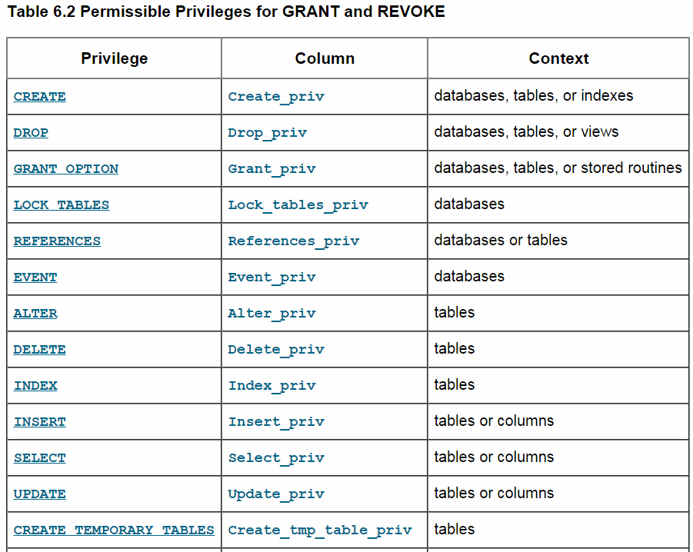
Permissible Privileges for GRANT and REVOKE
https://dev.mysql.com/doc/refman/5.6/en/privileges-provided.html

Slide 15
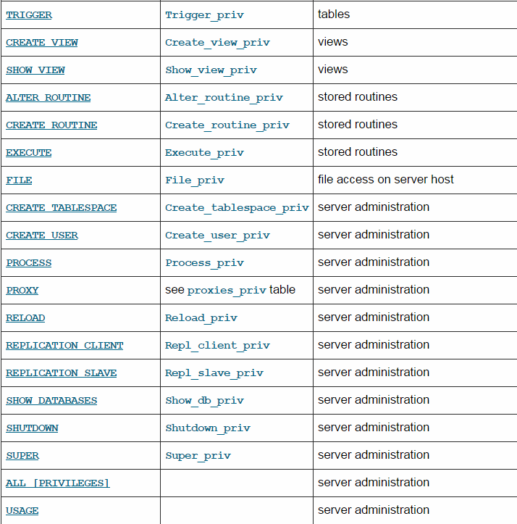
Permissible Privileges for GRANT and REVOKE
https://dev.mysql.com/doc/refman/5.6/en/privileges-provided.html

Slide 16
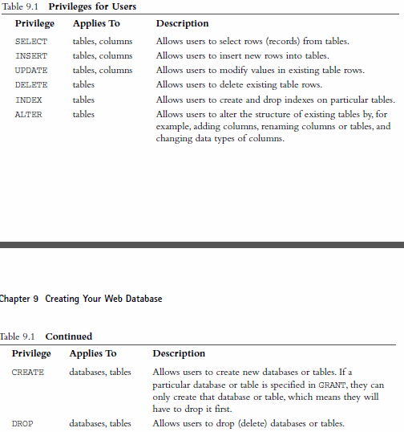
[1] Privileges for Users

Slide 17
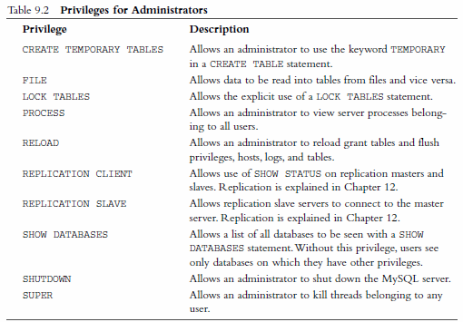
[2] Privileges for Administrators

Slide 18
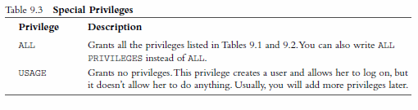
[3] Special Privileges

Slide 19
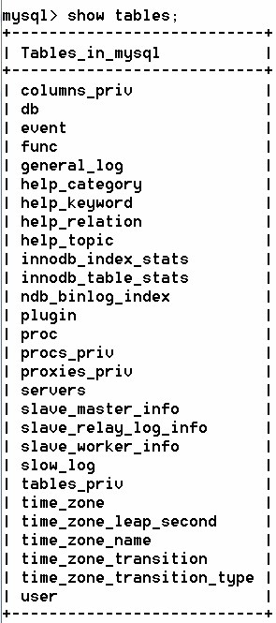
Where are all these privileges maintained?
mysql is one of the databases (system database) in MySQL.
All the privileges are stored in five system tables.
mysql.user
mysql.db
mysql.host
mysql.tables_priv
mysql.columns_priv
You typically use GRANT and REVOKE commands for managing the privileges.
However, MySQL administrators may alternatively manipulate these tables directly .

Slide 20
Updating / Flushing the Privileges
When mysqld starts, it reads all grant table contents into memory. The in-memory tables become effective for access control at that point.
If you modify the grant tables indirectly using account-management statements such as GRANT, REVOKE, or SET PASSWORD, the server notices these changes and loads the grant tables into memory again immediately.
If you modify the grant tables directly using statements such as INSERT, UPDATE, or DELETE, your changes have no effect on privilege checking until you either restart the server or tell it to reload the tables.
If you change the grant tables directly but forget to reload them, your changes have no effect until you restart the server.
To tell the server to reload the grant tables, perform a flush-privileges operation. This can be done by issuing a FLUSH PRIVILEGES statement or by executing a mysqladmin flush-privileges or mysqladmin reload command.

Slide 21
Examples of GRANT and REVOKE
mysql> grant all
→ on *
→ to fred identified by ‘mnb123’
→ with grant option;
mysql> revoke all privileges, grant
→ from fred;
mysql> grant usage
→ on books.*
→ to sally identified by ‘magic123’;
mysql> grant select, insert, update, delete, index, alter, create, drop
→ on books.*
→ to sally;
mysql> revoke alter, create, drop
→ on books.*
→ to sally;
mysql> revoke all
→ on books.*
→ from sally;
Granting everything on all (Basically setting up an administrator)
Revoking all from Fred
Setting up a regular user with no privileges
Giving several privileges to the same user
Revoking some of those privileges from the same user
Revoking everything from the user

Slide 22
Example parameters for GRANT
Argument | Meaning
*.* | All databases and their objects
xyz.* | Only the database called “xyz” and all its objects
xyz.abc | Only the database called “xyz” and all its object called “abc”.

Slide 23


Setting up a User for the web
For PHP Scripts to connect to MySQL, it is recommended to create another user with the privileges typically needed on web
SELECT, INSERT, DELETE, UPDATE
For some additional sophistication, you can also create the user as follows (with additional privileges of ..)
INDEX, ALTER, CREATE, DROP

Slide 24
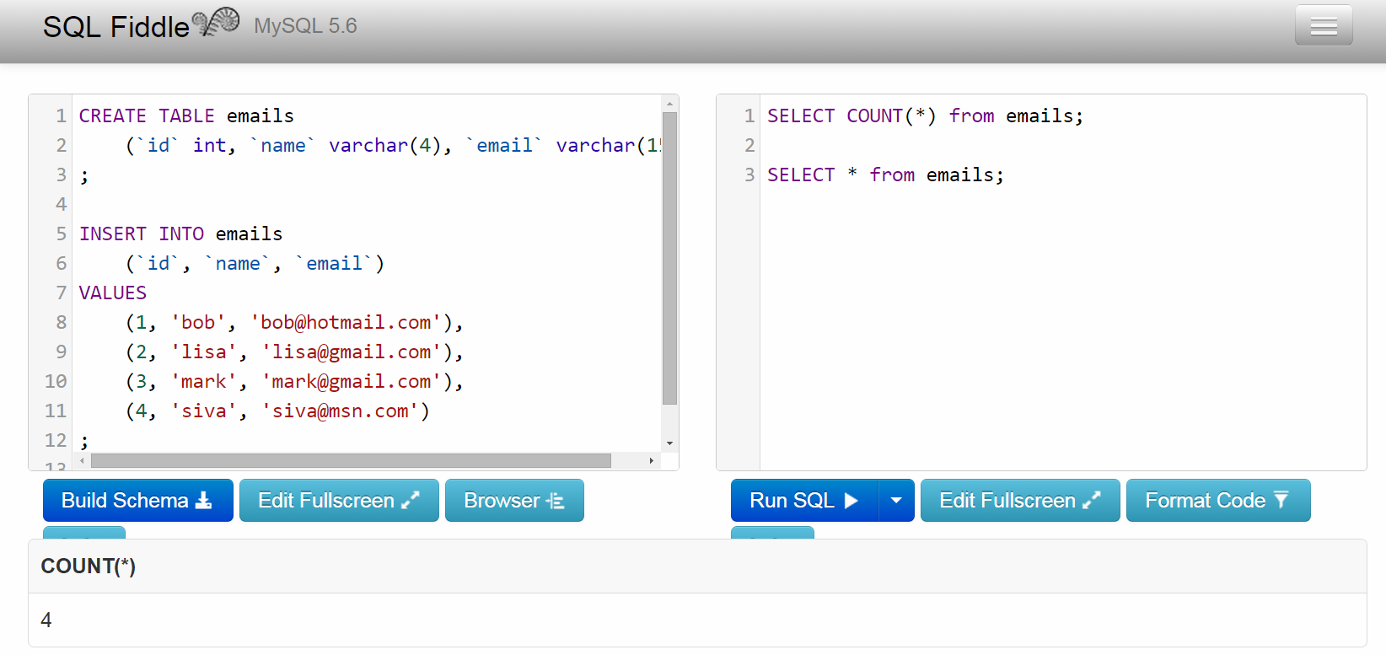
SQL Fiddle – A handy tool for SQL practice
Supports multiple database software or versions.
Handy tool for trying out SQL DDL (Data Definition Language) and Query statements
Also useful for quickly converting CSV data / table data / excel data into DDL
When seeking help on internet, you can simply share the URL of your fiddle
If you login via google+, it can actually remember your past queries so that you don’t have to remember or copy/paste those in notepad
Here is one of my fiddles http://sqlfiddle.com/#!9/1883f/2

Slide 25
Creating a user bookorama
mysql> select user from user;
+-----------+
| user |
+-----------+
| bookorama |
| root |
| root |
| pma |
| root |
+-----------+
5 rows in set (0.00 sec)
mysql> show databases;
+--------------------+
| Database |
+--------------------+
| information_schema |
| books |
| cdcol |
| mysql |
| performance_schema |
| phpmyadmin |
| webauth |
+--------------------+
7 rows in set (0.00 sec)
mysql> grant select, insert, update, delete, index, alter, create, drop
-> on books.*
-> to bookorama;
Query OK, 0 rows affected (0.00 sec)
// starting MySQL as root
D:\xampp\mysql\bin>mysql -u root
Welcome to the MySQL monitor. Commands end with ; or \g.
// Deleting anonmous users - one time
mysql> use mysql;
Database changed
mysql> delete from user where User='';
Query OK, 1 row affected (0.00 sec)
mysql> quit
Bye
// Reloading for the above to take into effect
D:\xampp\mysql\bin>mysqladmin -u root reload
// starting MySQL as root
D:\xampp\mysql\bin>mysql -u root
Welcome to the MySQL monitor. Commands end with ; or \g.
mysql> use mysql;
Database changed

Slide 26
Logging in as bookorama and checking the grants
mysql> quit
Bye
D:\xampp\mysql\bin>mysql -u bookorama -p
Enter password: ************
Welcome to the MySQL monitor. Commands end with ; or \g.
mysql> show grants;
+-------------------------------------------------------------------------------
-------------------+
| Grants for bookorama@%
|
+-------------------------------------------------------------------------------
-------------------+
| GRANT USAGE ON *.* TO 'bookorama'@'%' IDENTIFIED BY PASSWORD
|
| GRANT SELECT, INSERT, UPDATE, DELETE, CREATE, DROP, INDEX, ALTER ON `books`.*
TO 'bookorama'@'%' |
+-------------------------------------------------------------------------------
-------------------+
2 rows in set (0.00 sec)

Slide 27
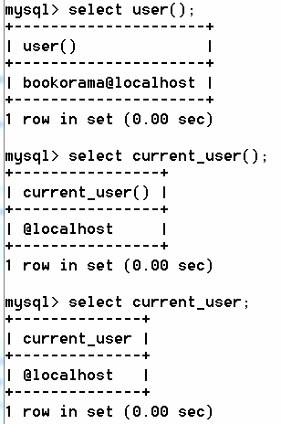
user( ) vs current_user( )
User() returns the user id through which you authenticated to start mysql server
Current_user() returns the user id using which mysql server actually authenticated you (and hence access permissions are set).
So, it is required to remove the anonymous user (as outlined in Appendix)
D:\xampp\mysql\bin>mysql -u root
mysql> use mysql;
Database changed
mysql> delete from user where User='';
Query OK, 1 row affected (0.00 sec)
mysql> quit
Bye
D:\xampp\mysql\bin>mysqladmin -u root reload

Slide 28
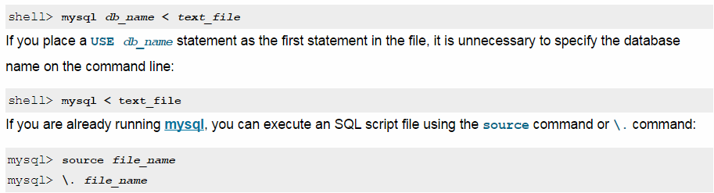
You can run the SQL commands from a file
(see Chapter 9 / bookorama.sql)
mysql> source D:\_PHP\BOOK ON CD Contents\Source\Chapter09\bookorama.sql
Query OK, 0 rows affected (0.03 sec)
Query OK, 0 rows affected (0.03 sec)
Query OK, 0 rows affected (0.02 sec)
Query OK, 0 rows affected (0.02 sec)
Query OK, 0 rows affected (0.03 sec)
mysql –h host –u bookorama –D books –p < bookorama.sql

Slide 29
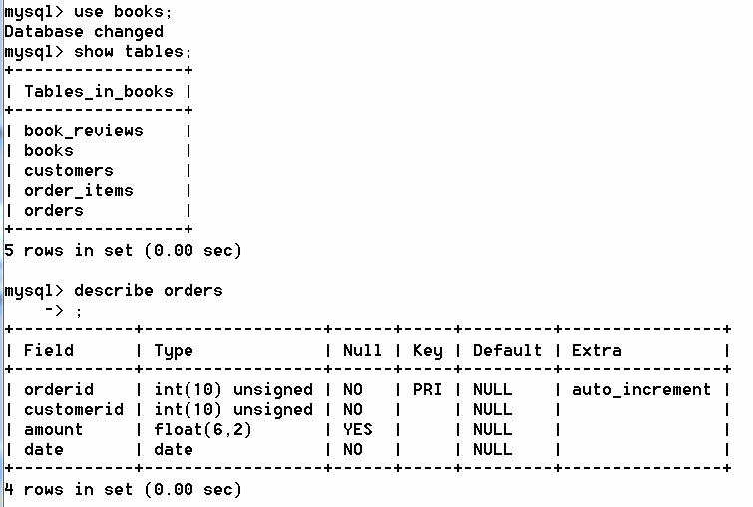
Checking whether tables are created or not
mysql> use books;
Database changed
mysql> show tables;
+-----------------+
| Tables_in_books |
+-----------------+
| book_reviews |
| books |
| customers |
| order_items |
| orders |
+-----------------+
5 rows in set (0.00 sec)
mysql> describe orders
-> ;
+------------+------------------+------+-----+---------+----------------+
| Field | Type | Null | Key | Default | Extra |
+------------+------------------+------+-----+---------+----------------+
| orderid | int(10) unsigned | NO | PRI | NULL | auto_increment |
| customerid | int(10) unsigned | NO | | NULL | |
| amount | float(6,2) | YES | | NULL | |
| date | date | NO | | NULL | |
+------------+------------------+------+-----+---------+----------------+
4 rows in set (0.00 sec)

Slide 30
Where are all databases / tables created?
These are created under data_dir
Database = directory name
Table Name = tablename.frm
Entire data is stored on a local file system (obviously, that is the ultimate destination).
Different operating systems have different rules when it comes to the rules governing the directory names and file names. (Some OS are case sensitive; And some OS permits spaces).
It makes sense to name all databases and tables without any spaces.

Slide 31
Column Data Types
Three basic column types:
Numeric
Date
Time
With in each category, there are large number of types (depending up on the precision and type)

Slide 32
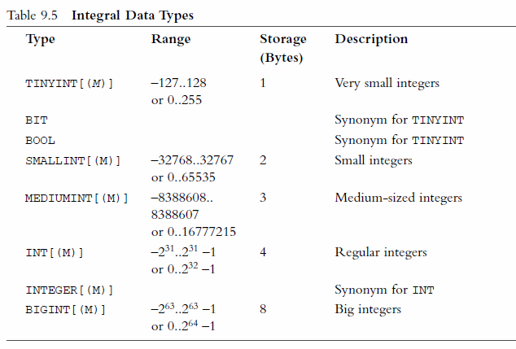
Integral Data Types (Integers)

Slide 33
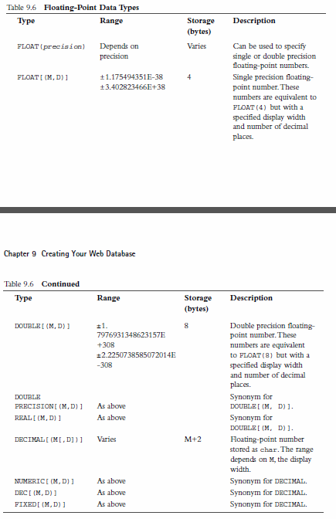
Floating Point Data Types

Slide 34
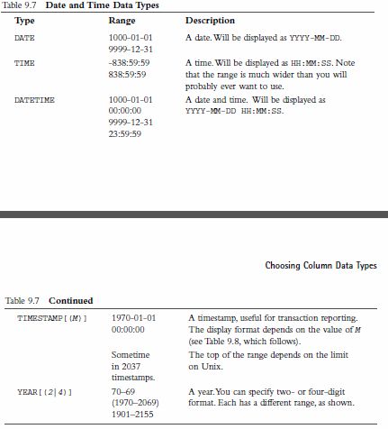
Date and Time Data Types

Slide 35
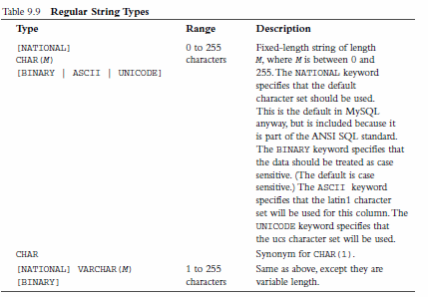
Regular String Types

Slide 36
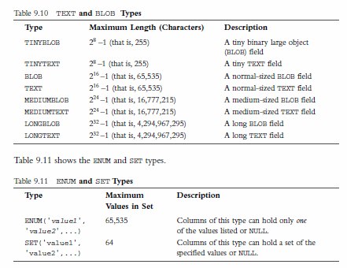
TEXT and BLOB; ENUM and SET types

Slide 37
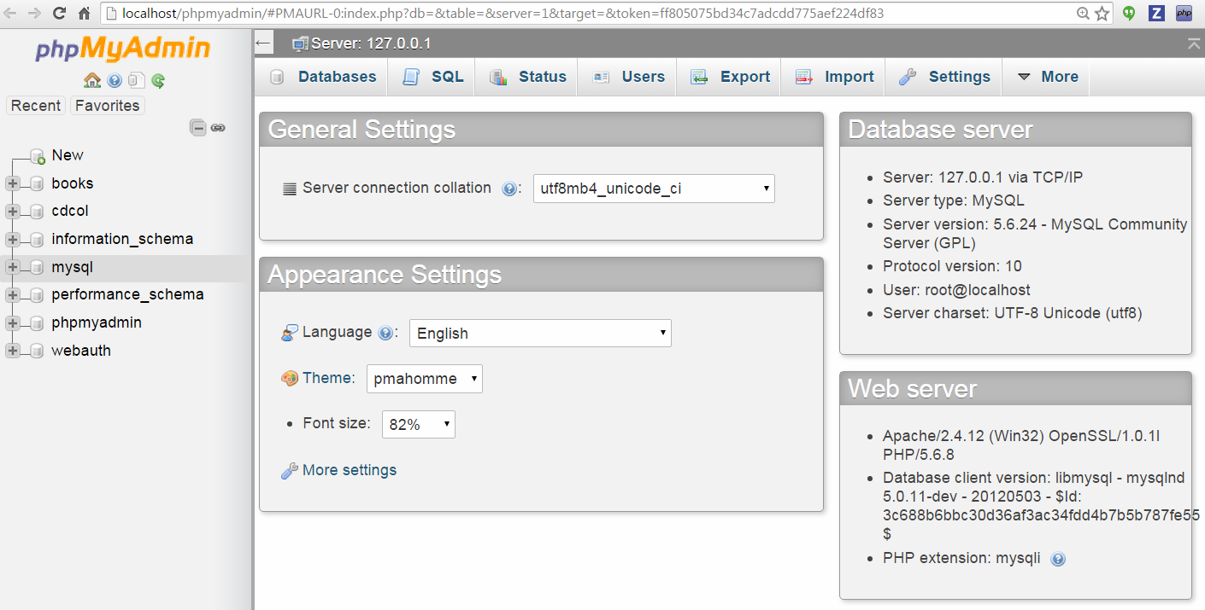
myphpadmin – web client on XAMPP
All the things we have done through command line prompt can also be done through GUI. However, understanding how SQL functions and the commands behind each of the functionality is important.

Slide 38
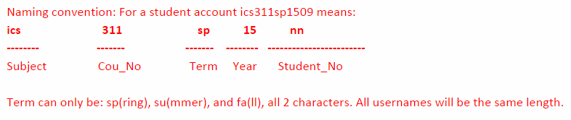
Logging in metrostate linux server
SP-CFSICS.METROSTATE.EDU
Each of are you provided a user name and password to connect to metrostate linux server.
You are also given MySQL user name and password. That is to launch mysql instance on the linux server.
You are already given a database (same as your user name). You don’t have additional privileges to create additional databases. So, any new tables you create will have to be in the same database

Slide 39
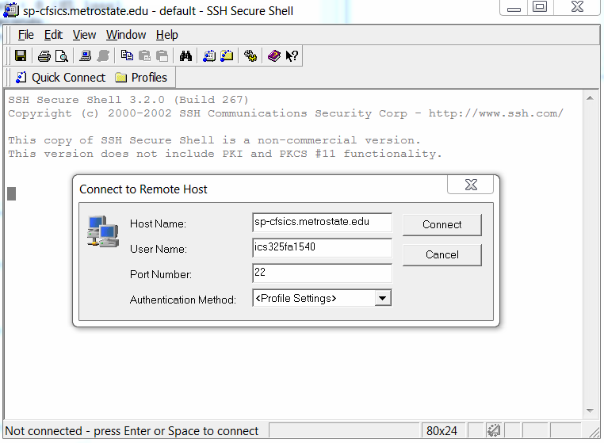
Logging in metrostate linux server
SP-CFSICS.METROSTATE.EDU

Slide 40
Summary
What we covered here is just DDL (Data Definition Language).
Now, you know how to create
Databases
Tables
Users
Granting them privileges
You also know how to run a series of DDL statements through file.
You know how to login to your XAMPP as well as to metrostate linux server.

